Slide 1
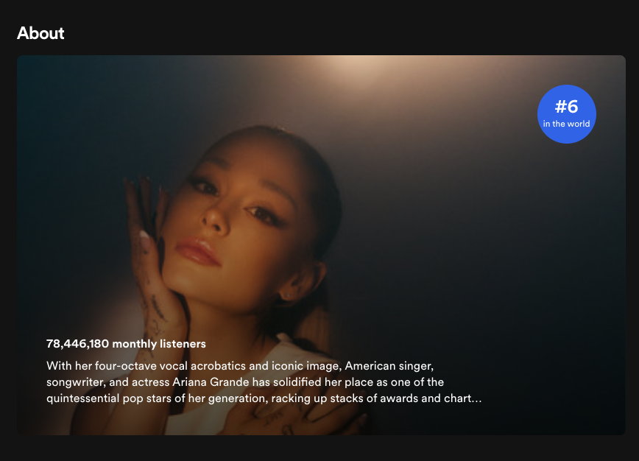
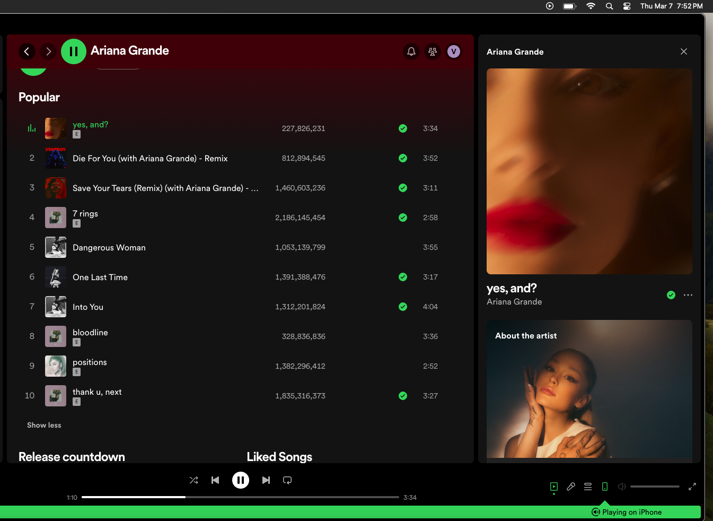
Audio Analysis in songs

Slide 2

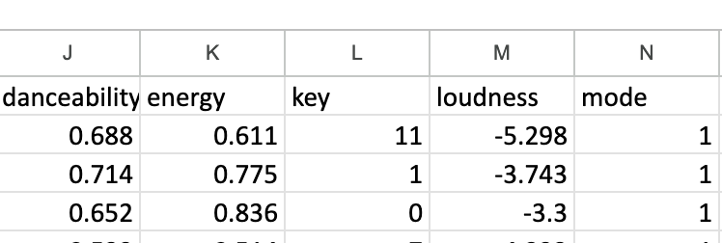
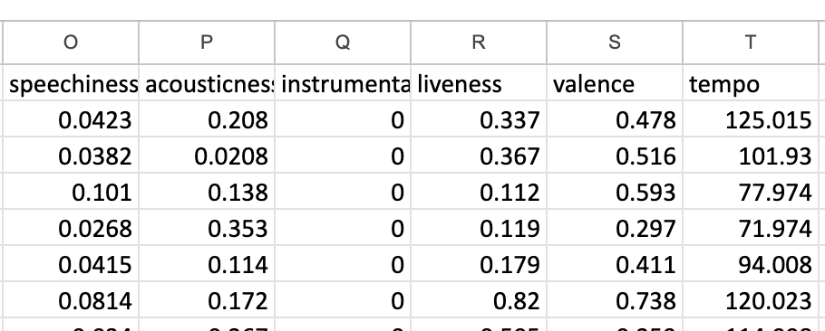
Audio Analysis Features
'Danceability' 💃🏻🕺🏻
'Energy' ⚡️
'Loudness' 📣
'Acousticness' 🎸
'Instrumentalness' 🎹
'Liveness' 🤟🏻
'Valence' 😍
'Tempo' ⏰
Musical Positiveness
Valence: A measure from 0.0 to 1.0 describing the musical positiveness conveyed by a track. Tracks with high valence sound more positive (e.g. happy, cheerful, euphoric), while tracks with low valence sound more negative (e.g. sad, depressed, angry).

Slide 3
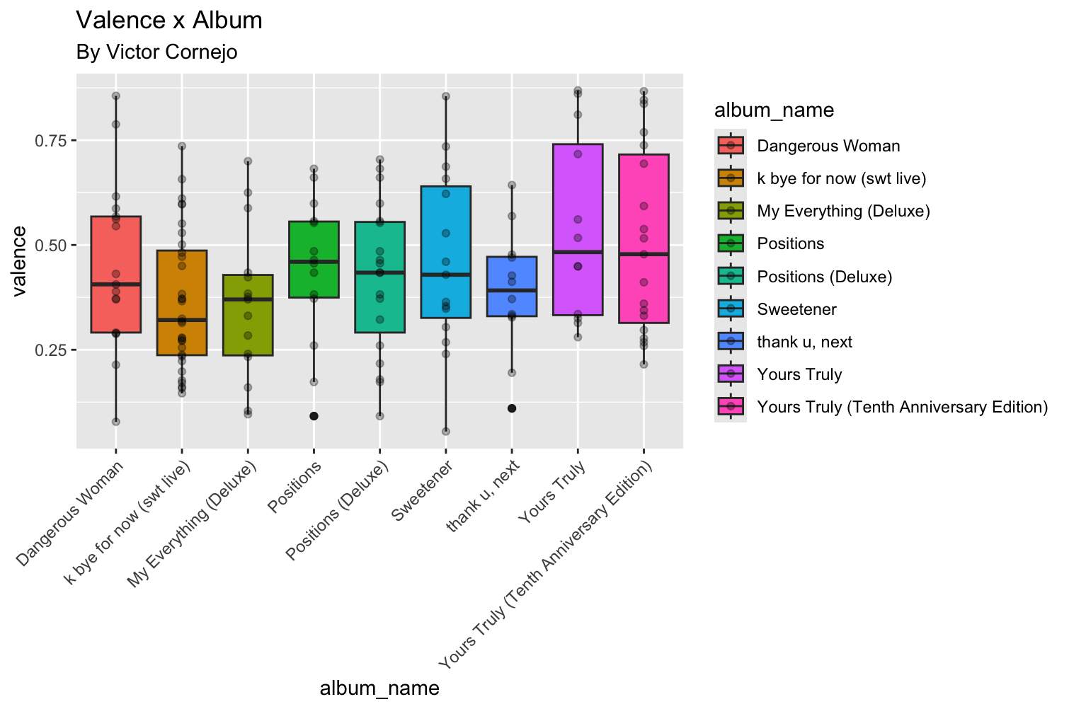

Slide 4
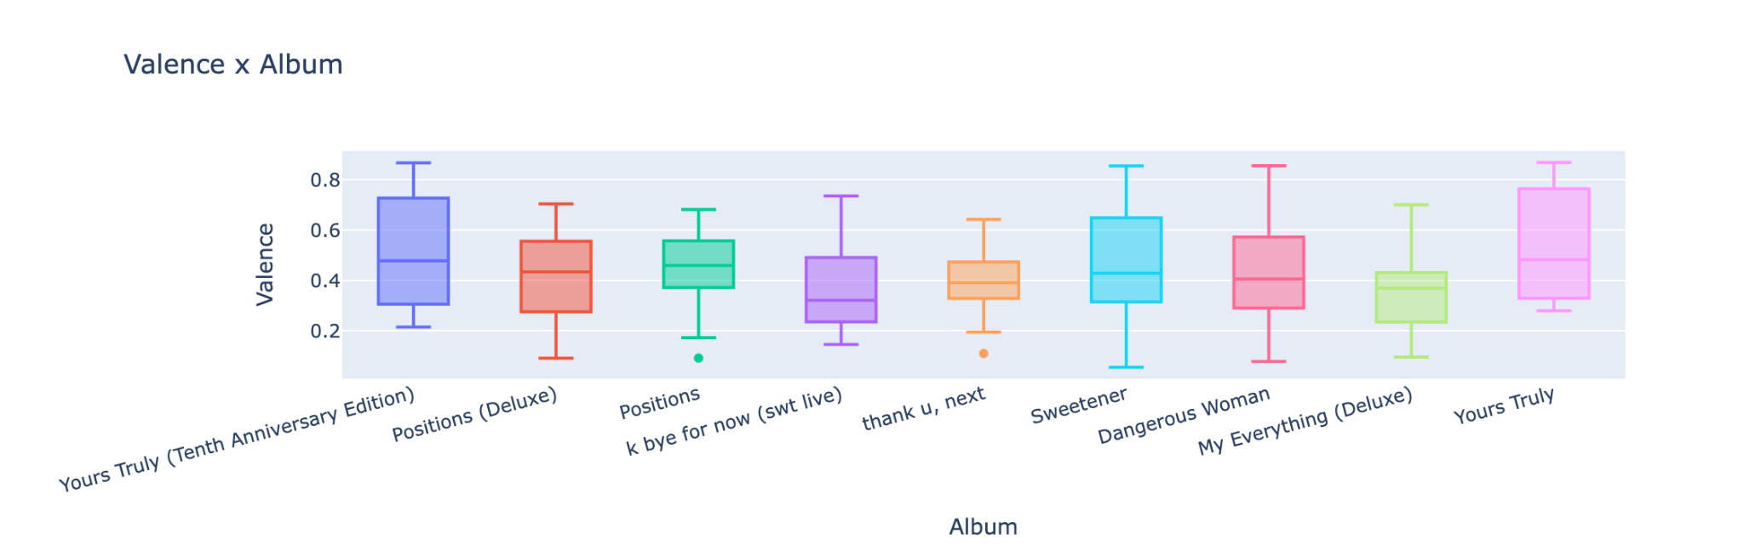
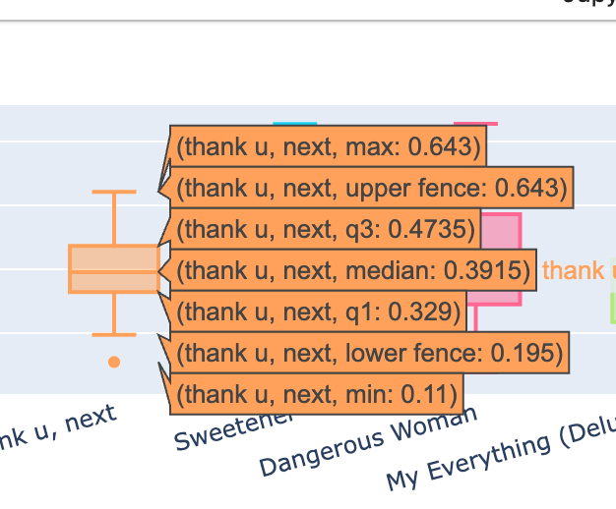
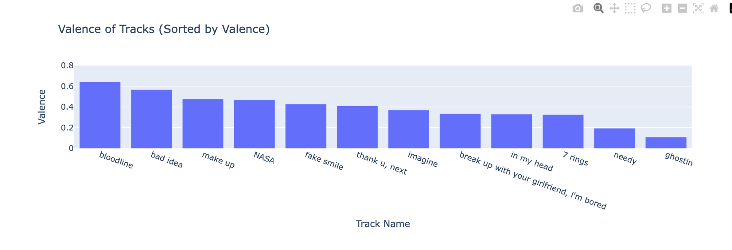

Slide 5
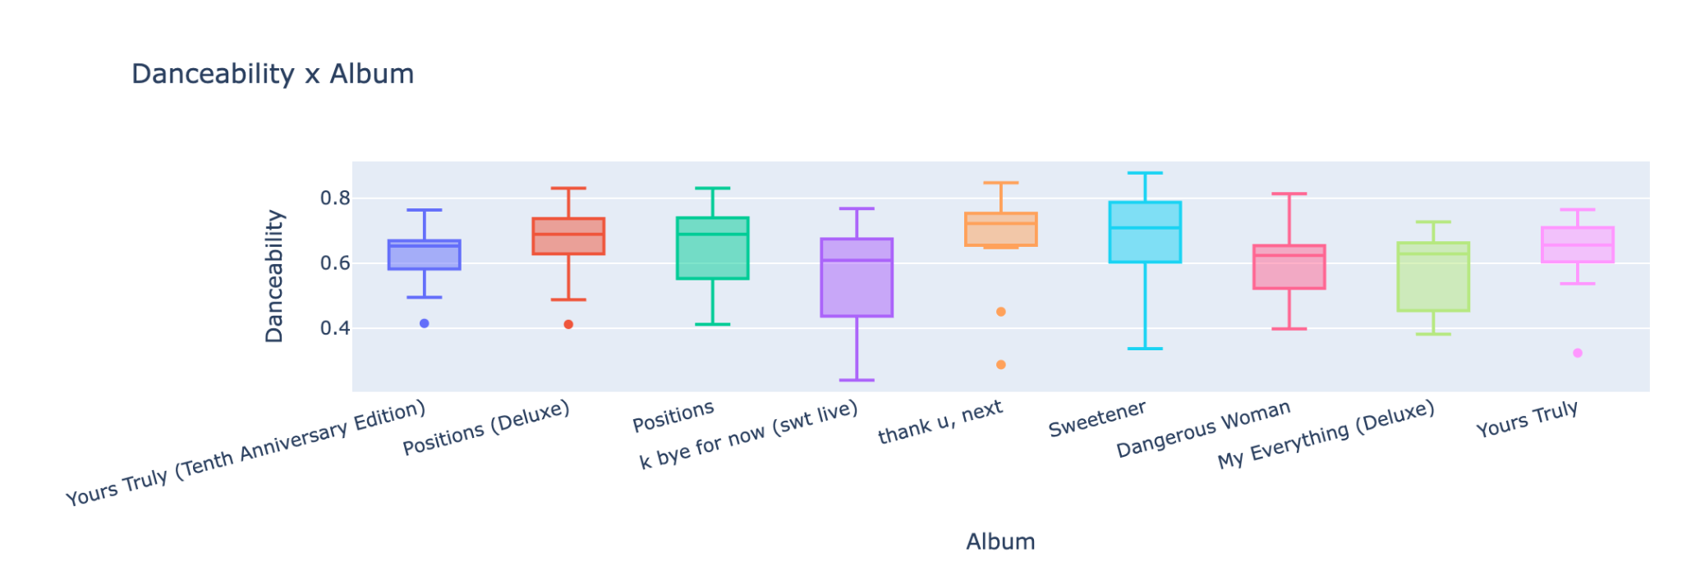
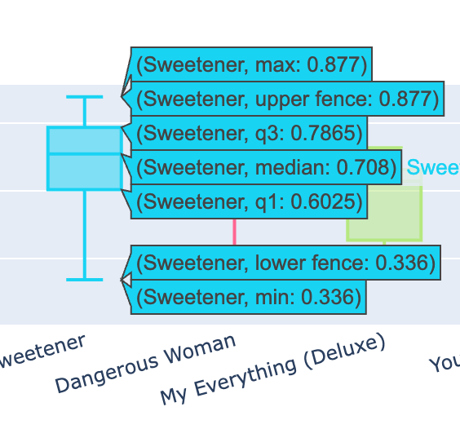
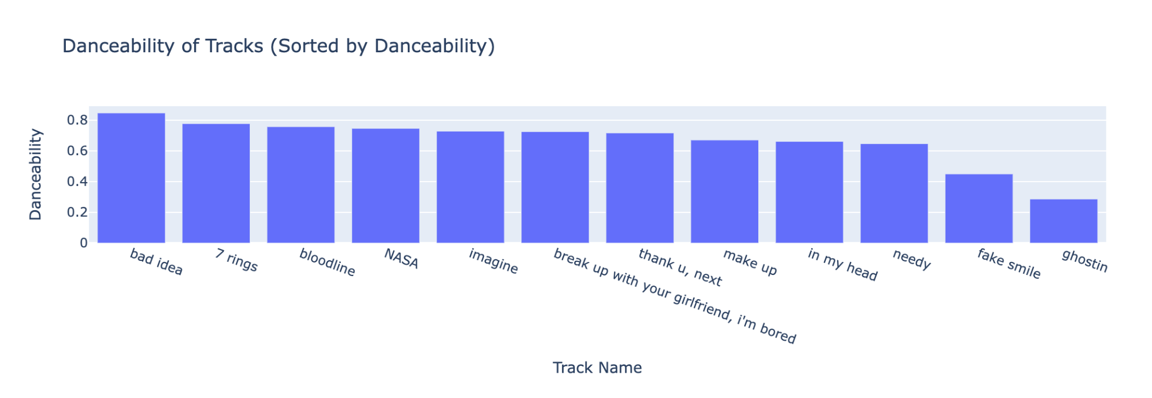

Slide 8
For future Analysis with Logistic Regression is to predict log streams per feature by artist…
THANKS :)

